Slide 1


Slide 2
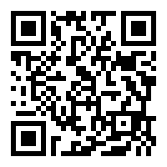
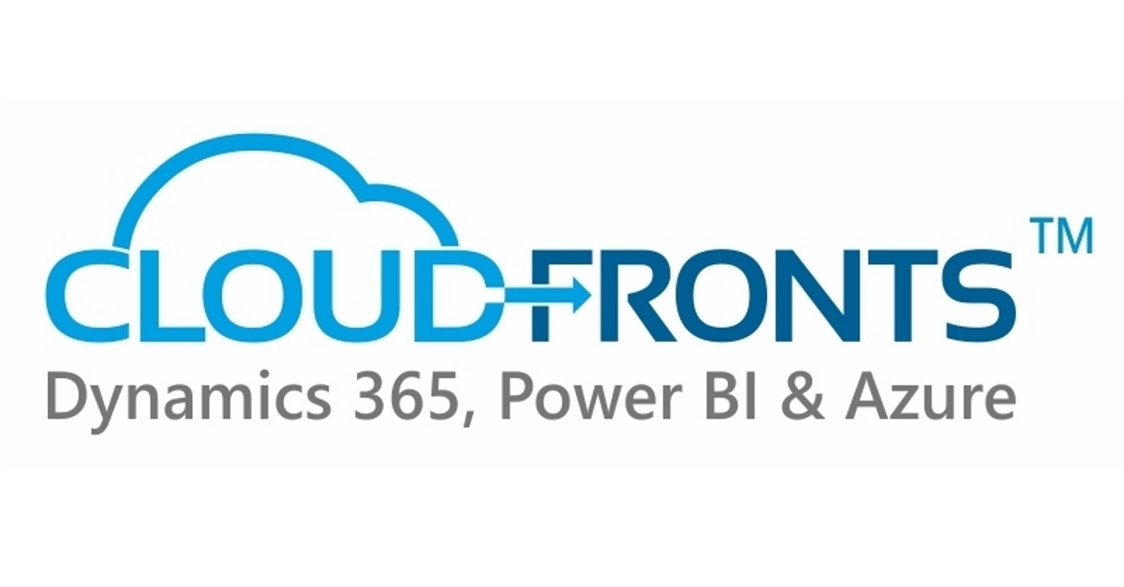

Olister Rumao
Dynamics NAV / Business Central Techno-Functional Consultant
CloudFronts, Mumbai
Blog: https://www.olisterr.tech/

Slide 3
Agenda
API V1.0 in Business Central
Existing APIs in Business Central API V1.0
Creating APIs in Business Central
Using APIs to Integrate data with Business Central

Slide 4
Existing APIs in Business Central API V1.0
List of APIs
List of Companies
List of APIs present Out-Of-the-Box
Filtering the Data in API

Slide 5
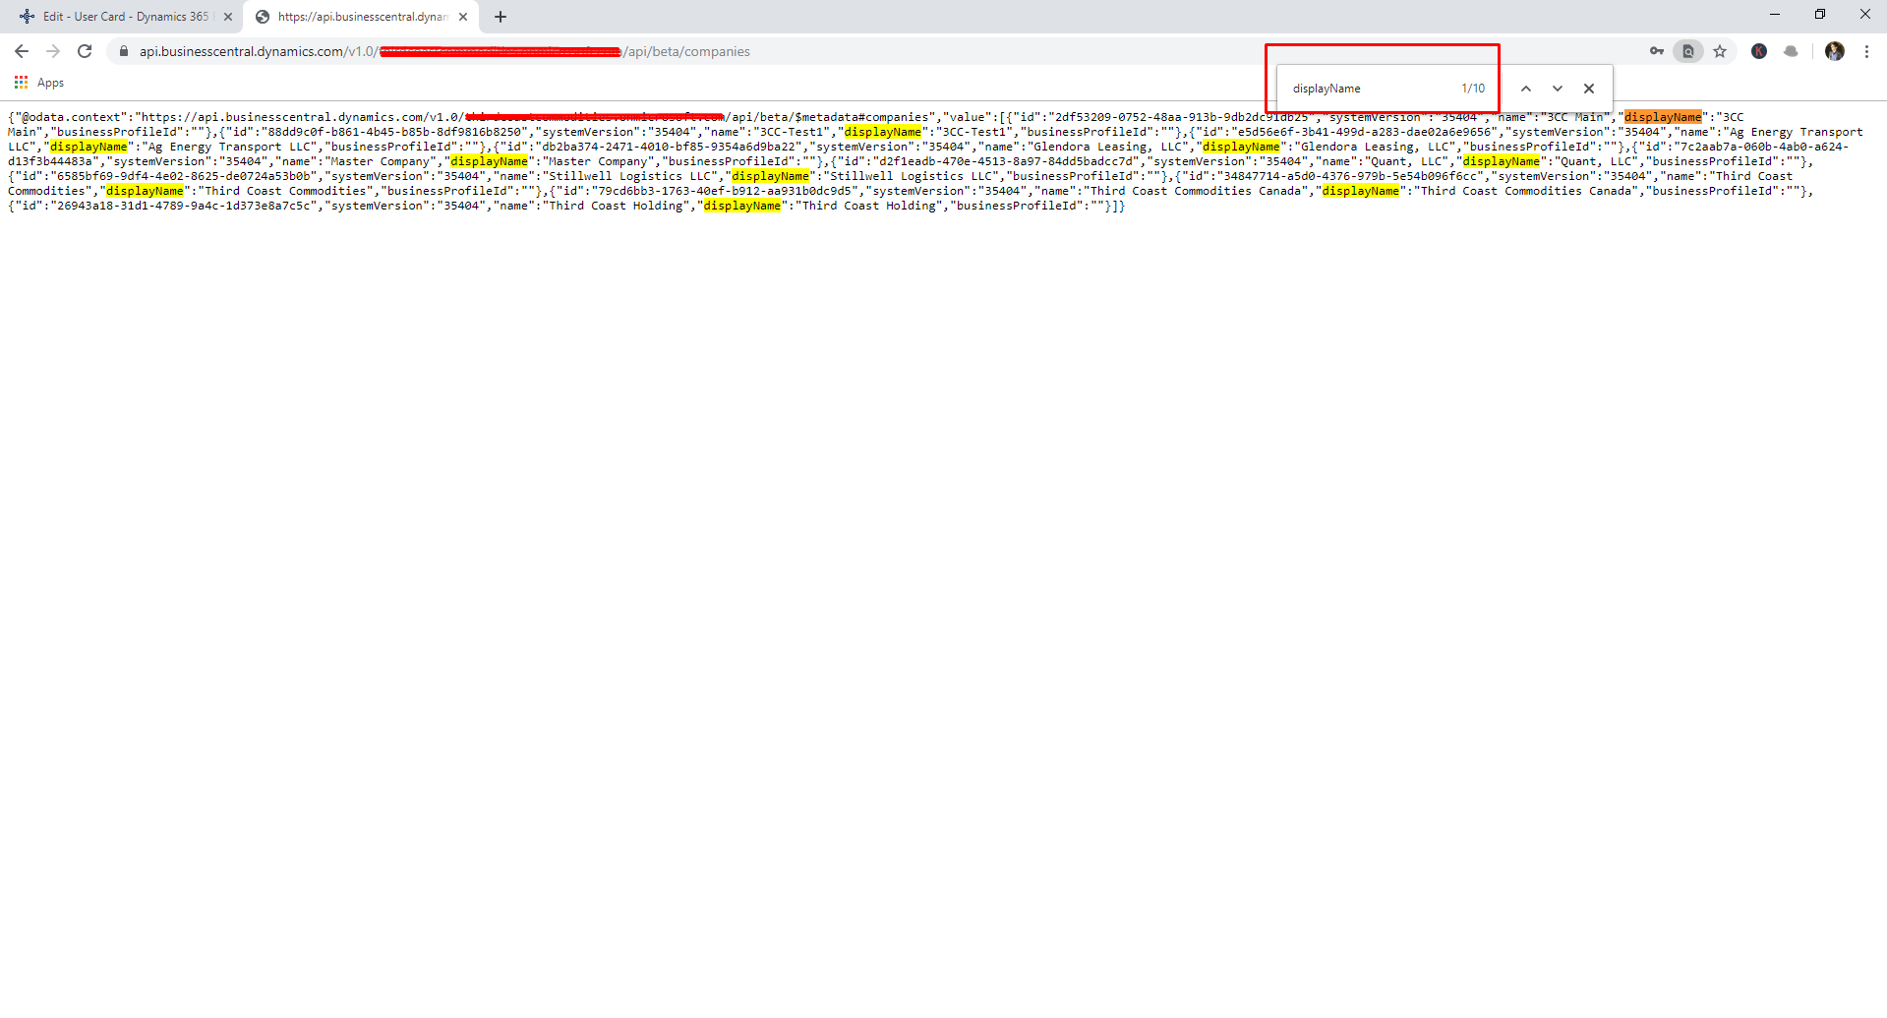
List of Companies
URL: https://api.businesscentral.dynamics.com/v1.0/<TenantID>/api/v1.0/companies

Slide 6
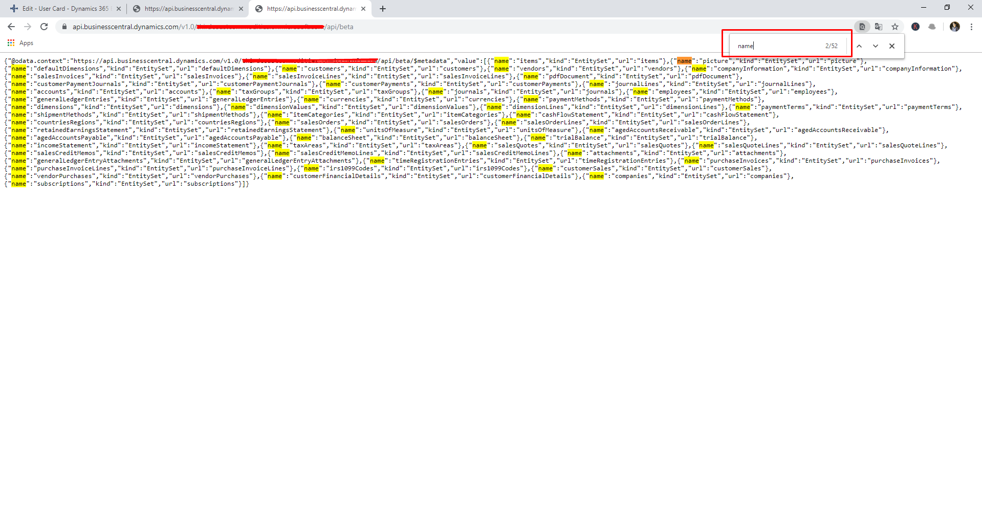
List of APIs (Out-Of-the-Box)
URL: https://api.businesscentral.dynamics.com/v1.0/<TenantID>/api/v1.0/

Slide 7
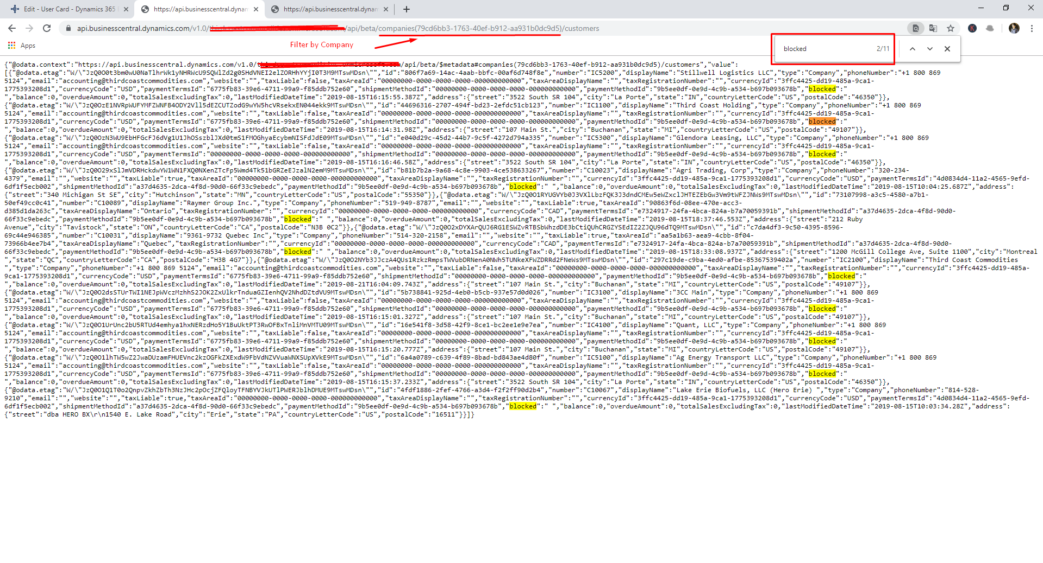
List of Customers by selecting the Company
URL: https://api.businesscentral.dynamics.com/v1.0/<TenantID>/api/v1.0/
companies(CompanyID)/customers

Slide 8
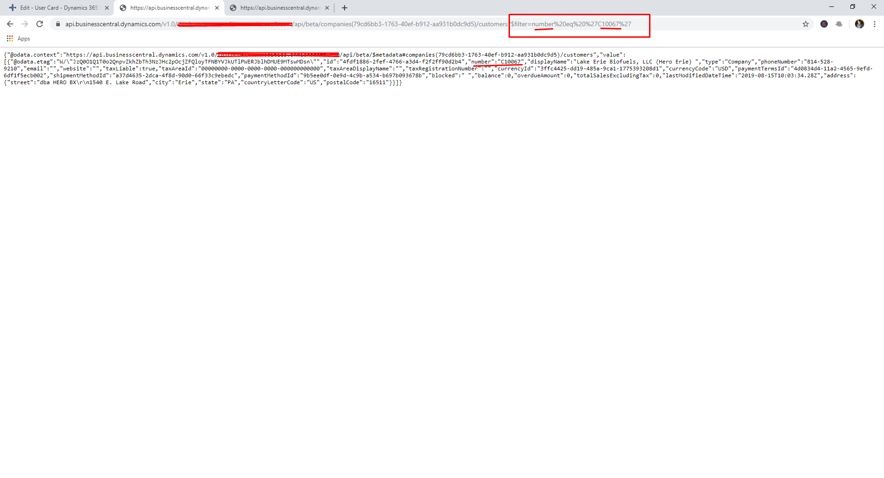
List of Customers by Filtering by Text/Code Fields
URL: https://api.businesscentral.dynamics.com/v1.0/<TenantID>/api/v1.0/
companies(CompanyID)/customers?$filter=<FilterField>%20<Opertor>%20%27<Value>%27

Slide 9
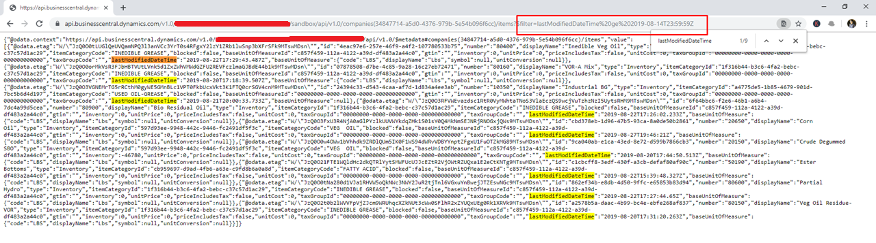
List of Customers by Filtering by DateTime Fields
URL: https://api.businesscentral.dynamics.com/v1.0/<TenantID>/api/v1.0/
companies(CompanyID)/items? $filter=<TimeStampField>%20<Operator>%20<Value>

Slide 10
Creating Custom APIs
Creating APIs
i. Creating Tables ii. Creating API Page
iii. Adding API(Part) into another API
iv. Creating OData EDM
Customizing Existing APIs
i. Creating Table Extension
ii. Creating API Page Extension

Slide 11
Creating APIs
Creating Tables
Creating API Page
Adding API(Part) into another API
Creating OData EDM

Slide 12
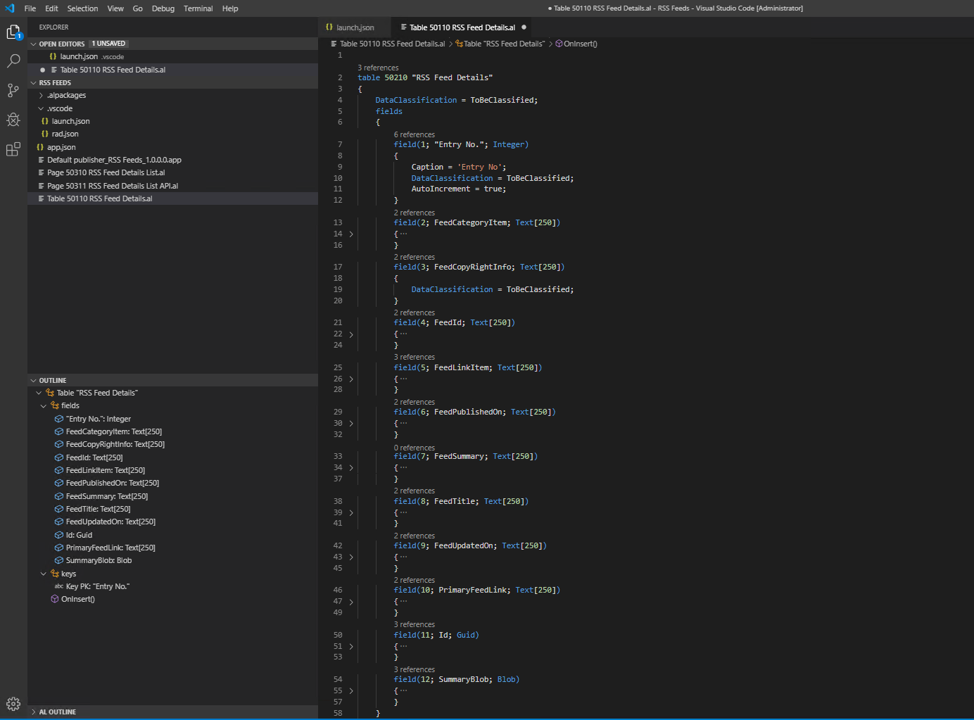
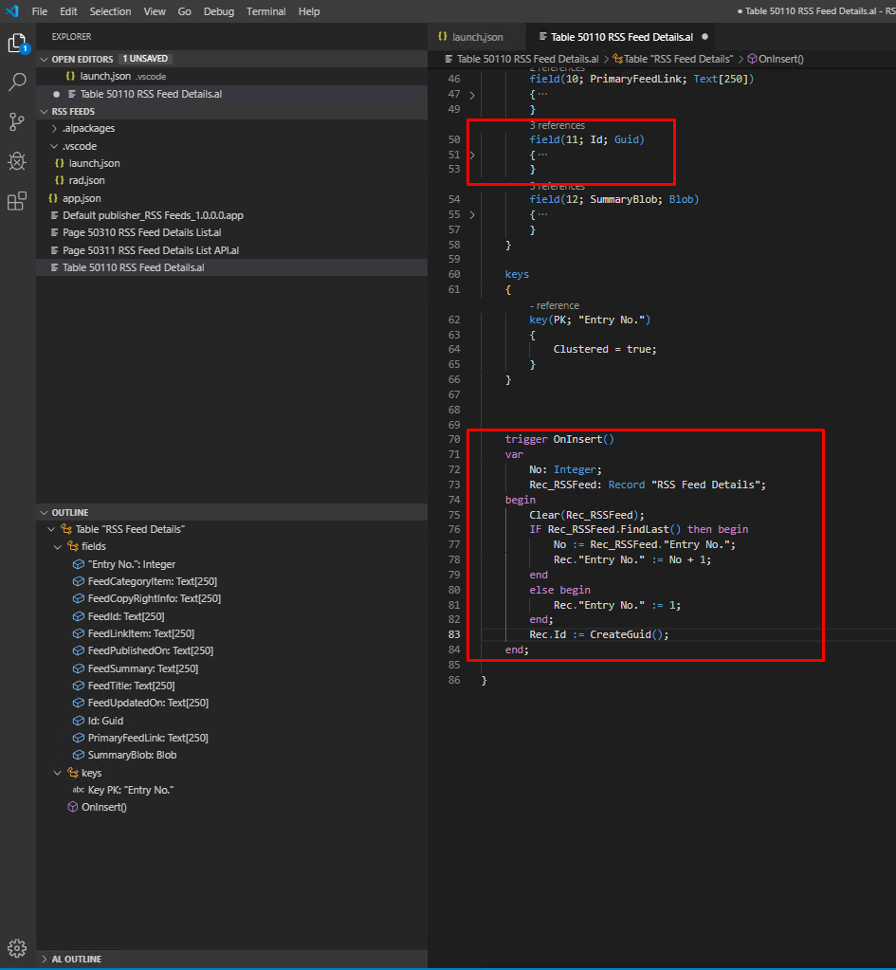
Creating Tables

Slide 13
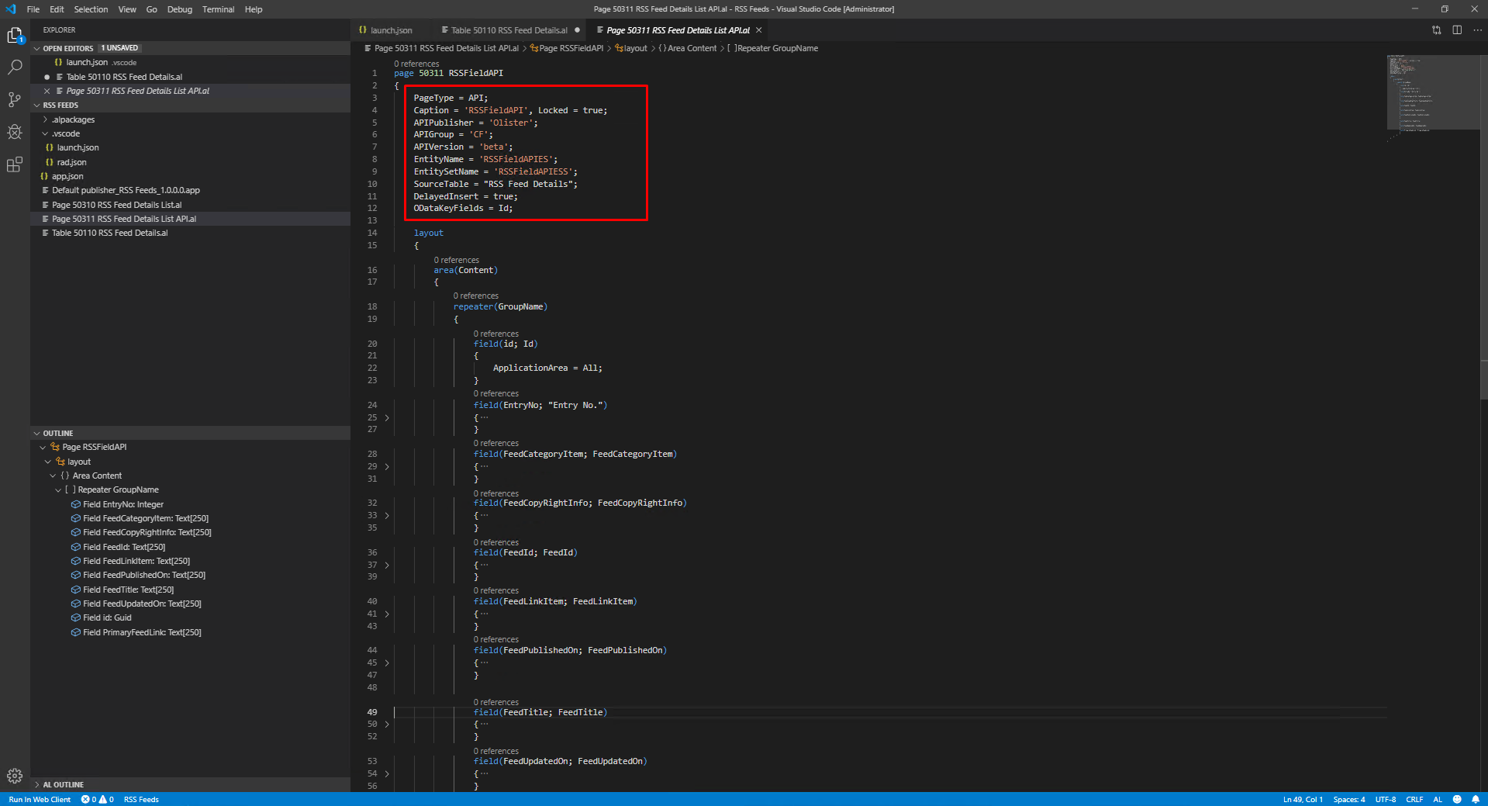
Creating API Page

Slide 14
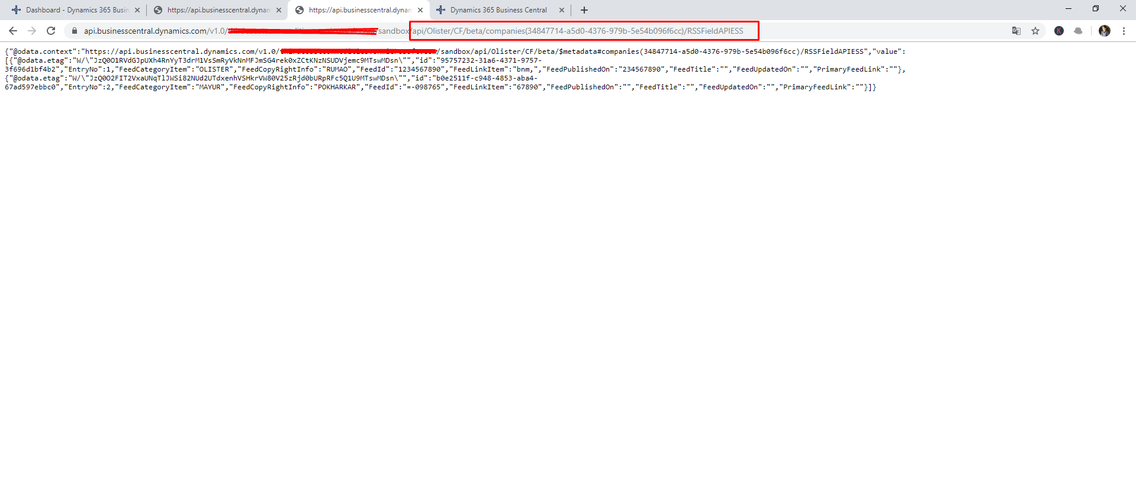
Custom API (Output)

Slide 15
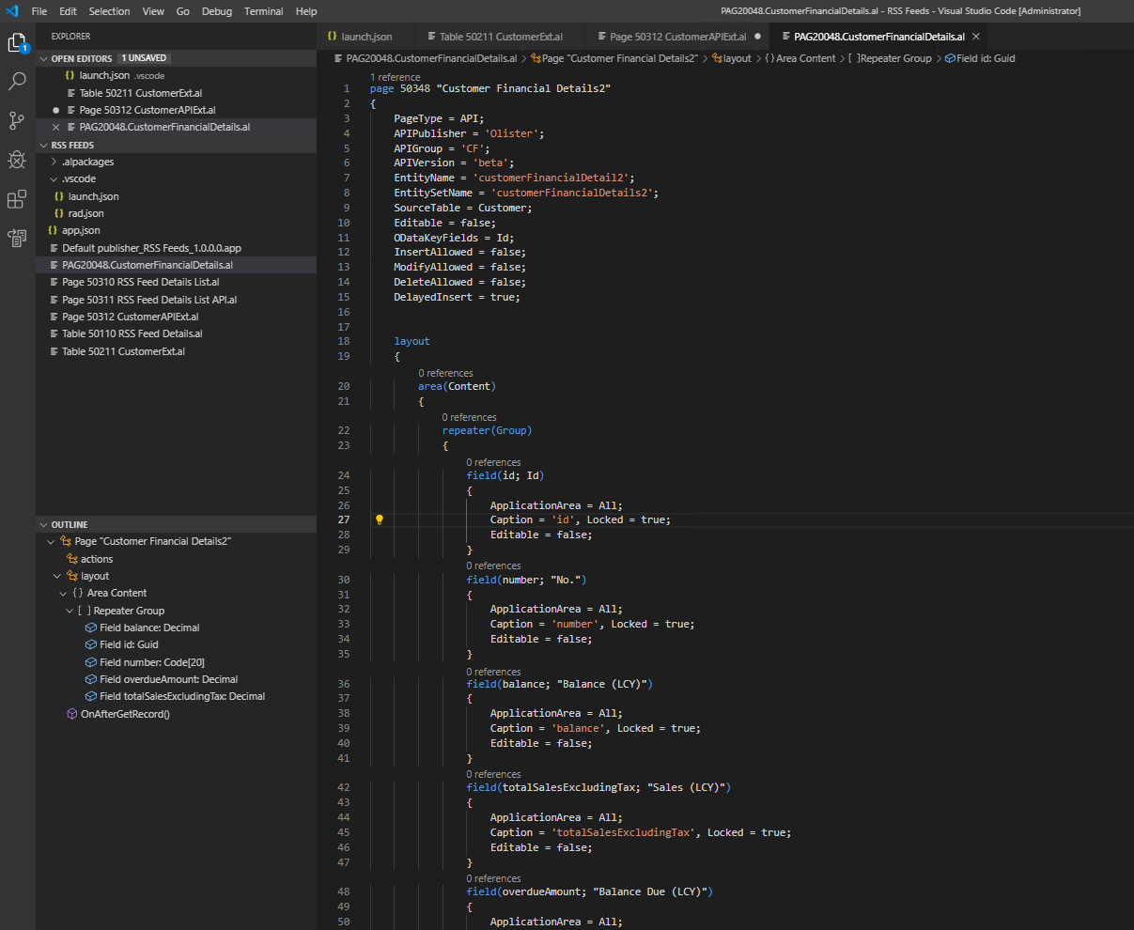
Adding API(Part) into another API – API Part

Slide 16
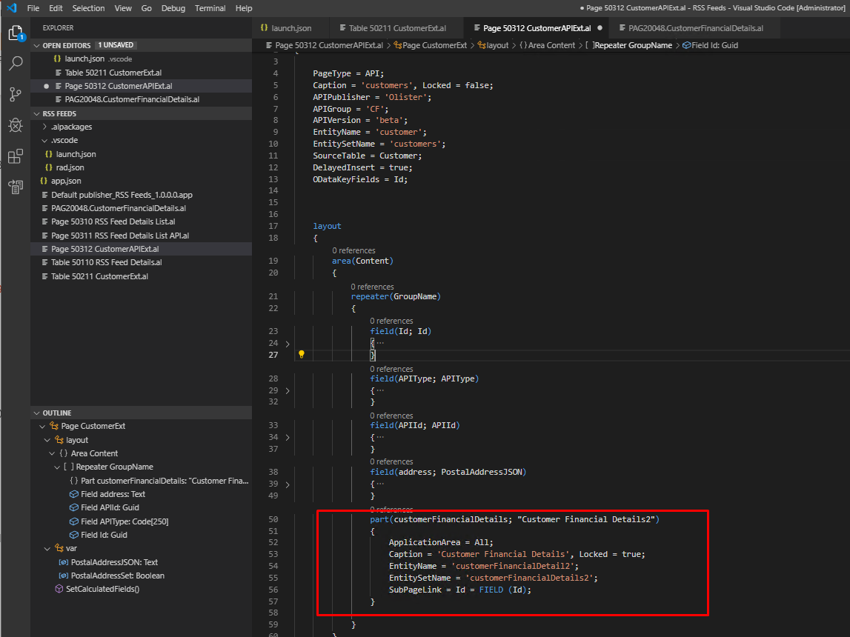
Adding API(Part) into another API – Linking API Part to Parent API

Slide 17
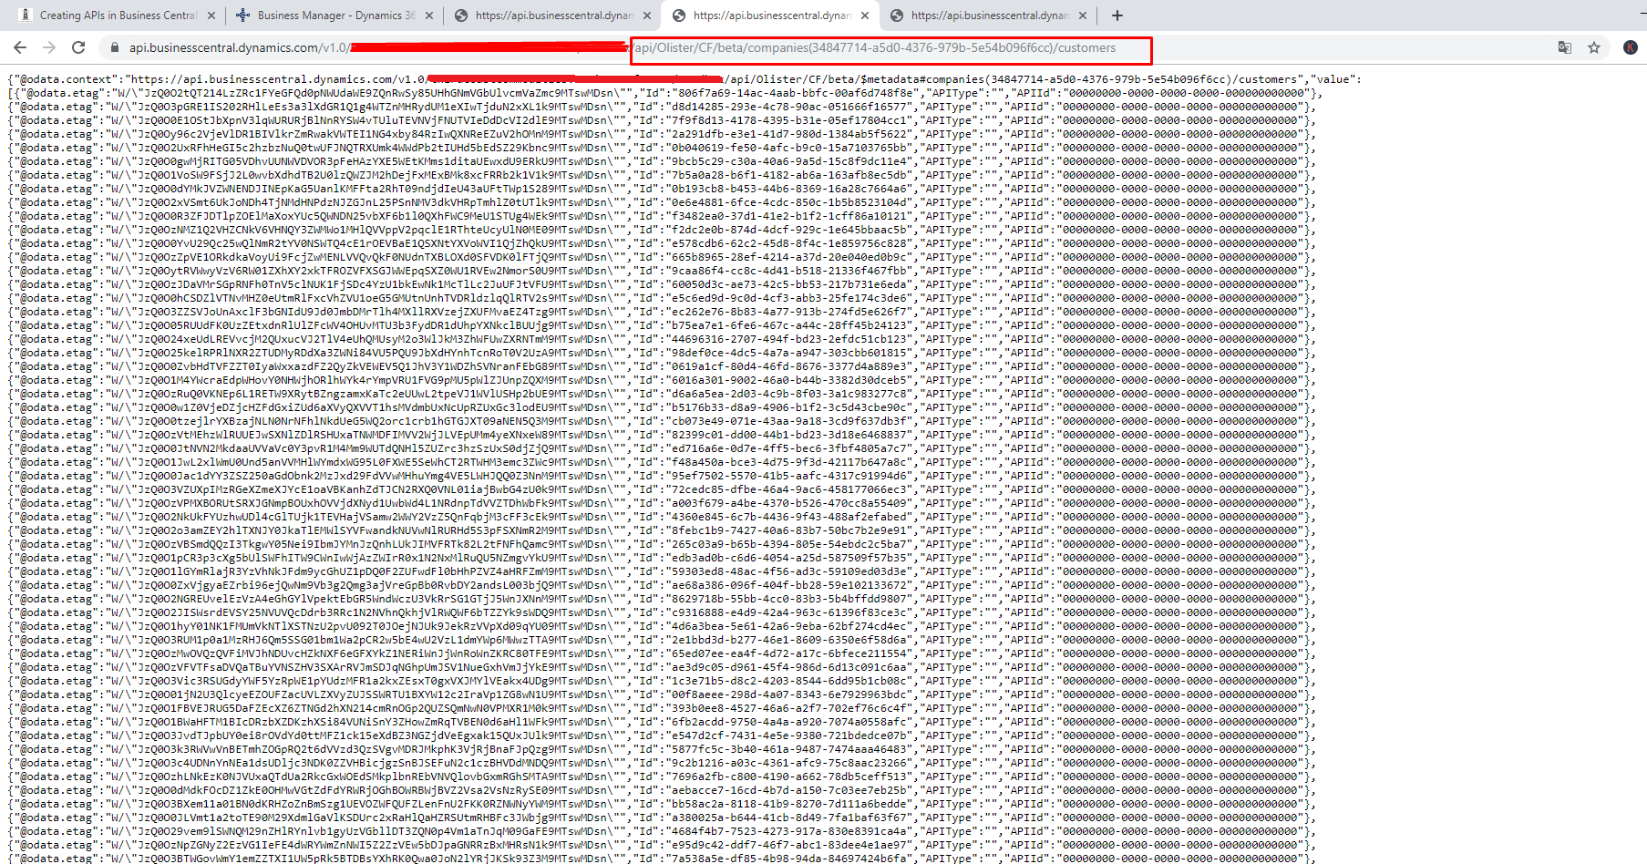
Adding API(Part) into another API – Parent API Page

Slide 18
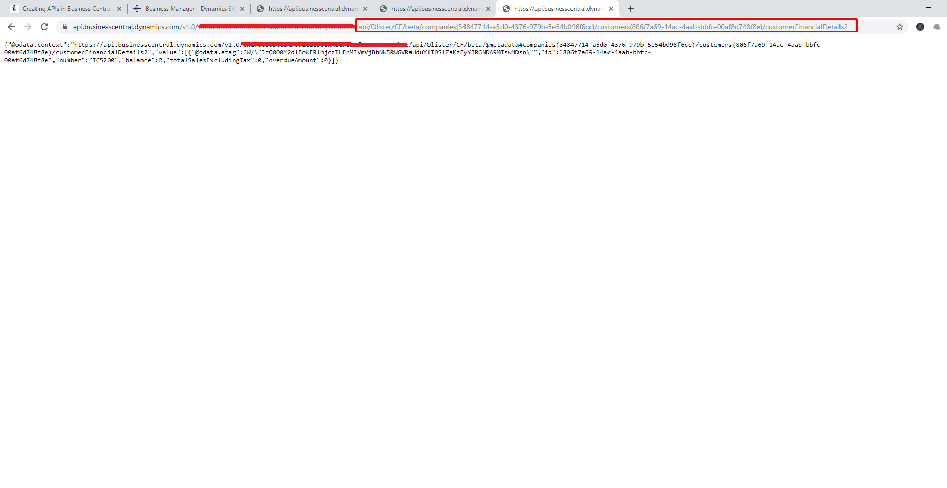
Adding API(Part) into another API – Part API Page

Slide 19
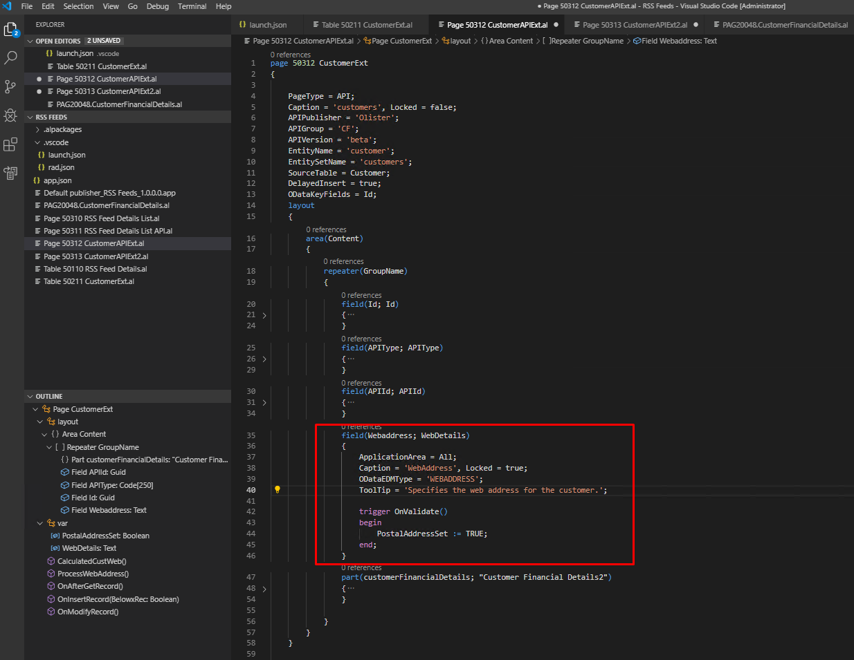
Creating OData EDM – Adding Fields & OData EDM Type

Slide 20
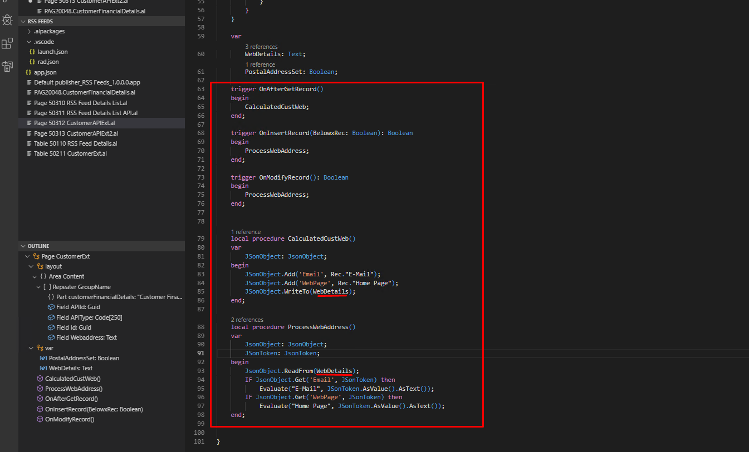
Creating OData EDM – Adding Triggers to Get & Set Data

Slide 21
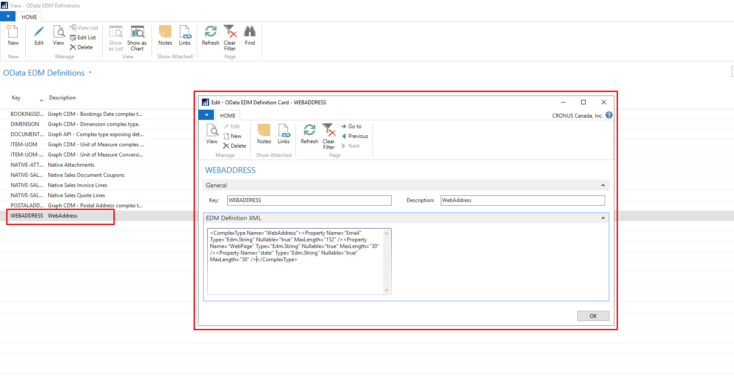
Creating ODATA EDM Definition – Only for BC-ONPREMISE

Slide 22
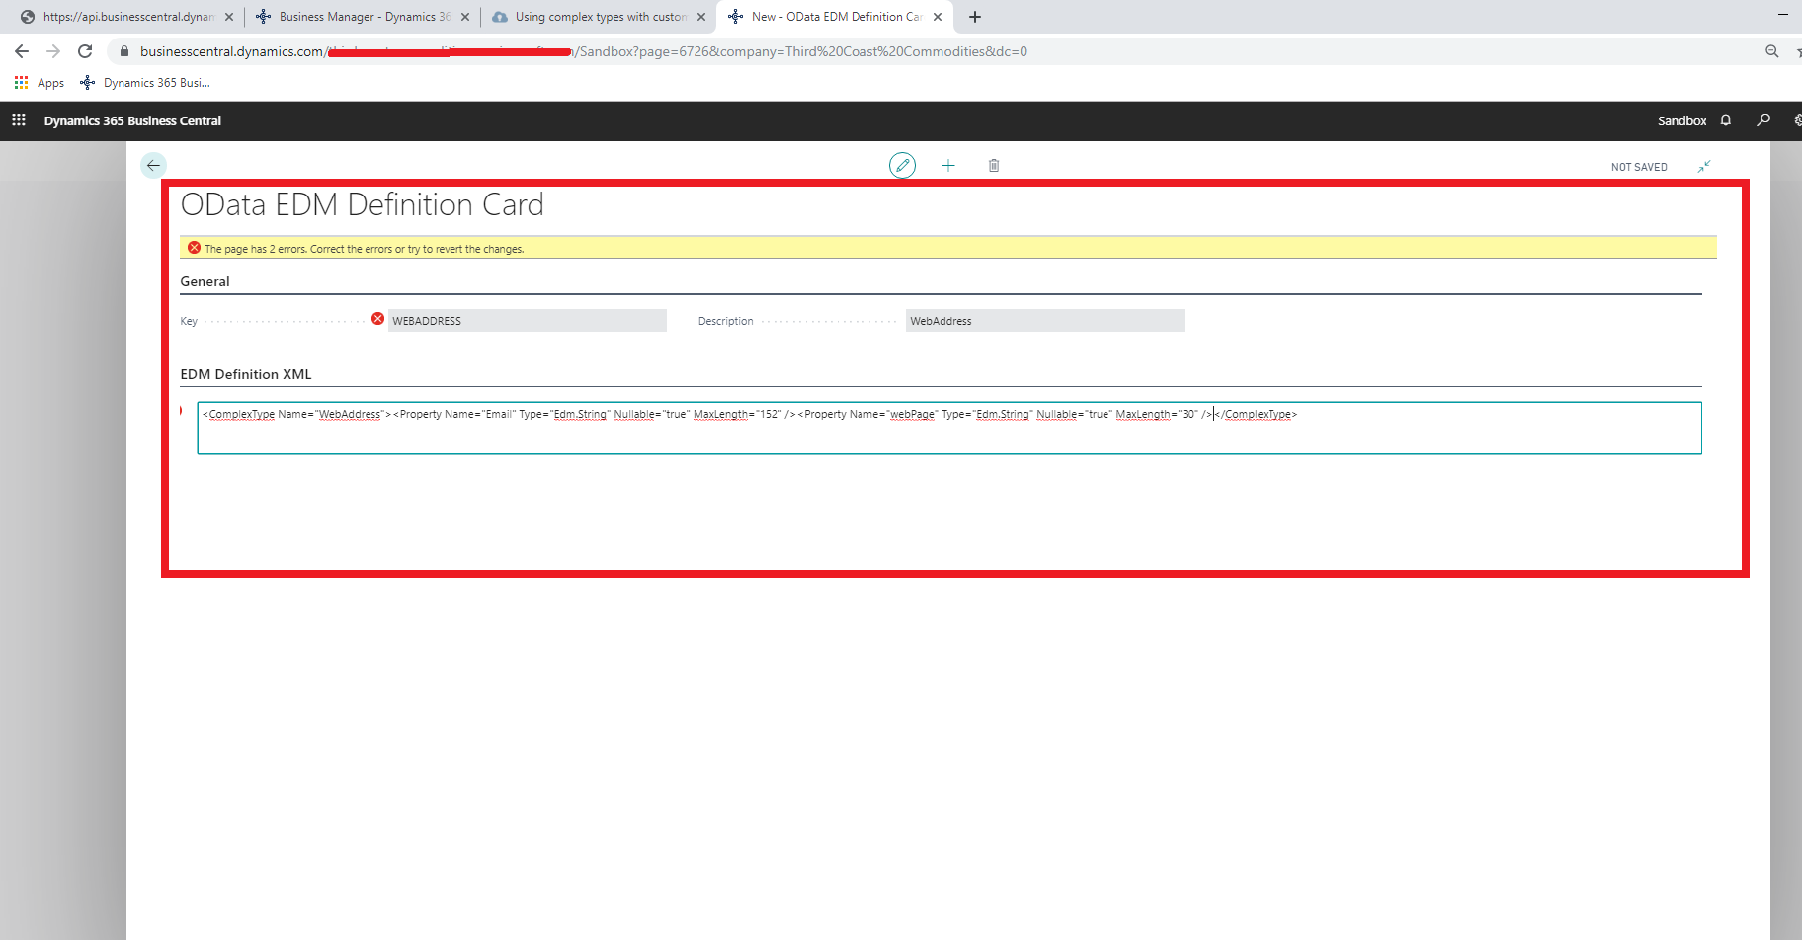
Creating ODATA EDM Definition – Error on BC - SaaS

Slide 23
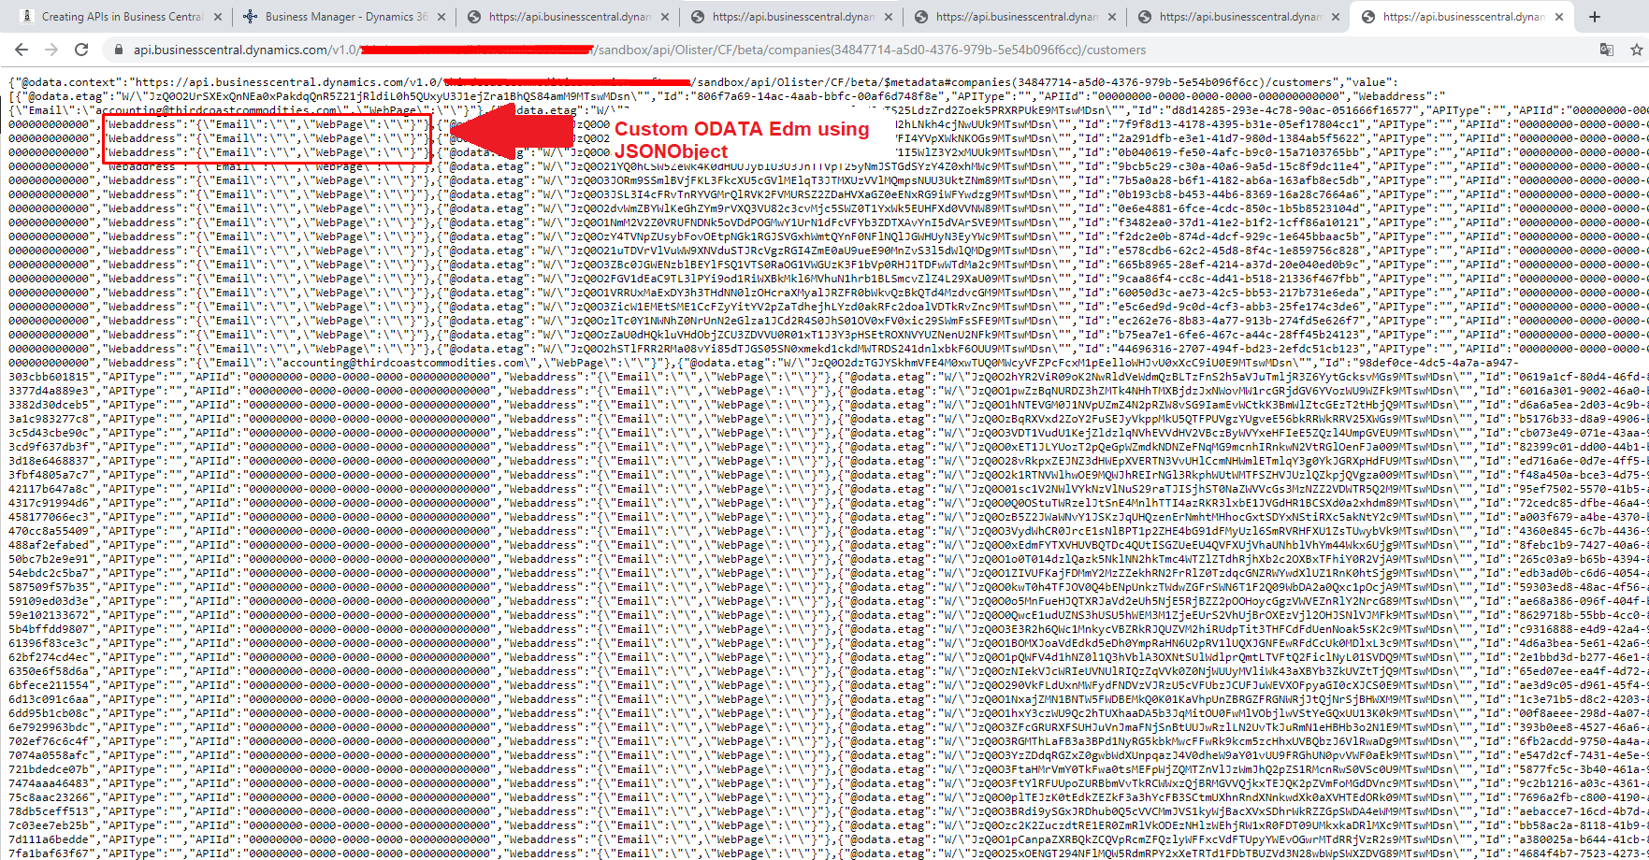
API with Custom ODATA EDM (Read Only)

Slide 24
Customizing Existing APIs
Creating Table Extension
Creating API Page Extension

Slide 25
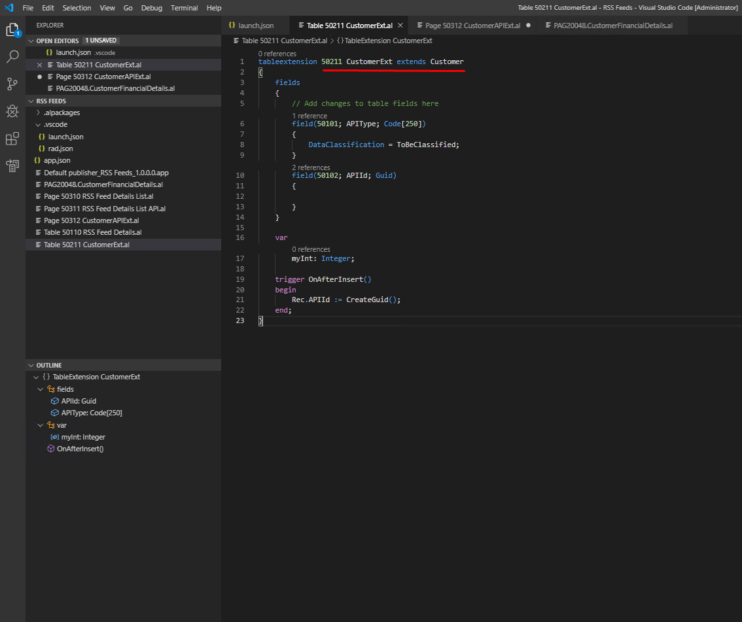
Creating Table Extension

Slide 26
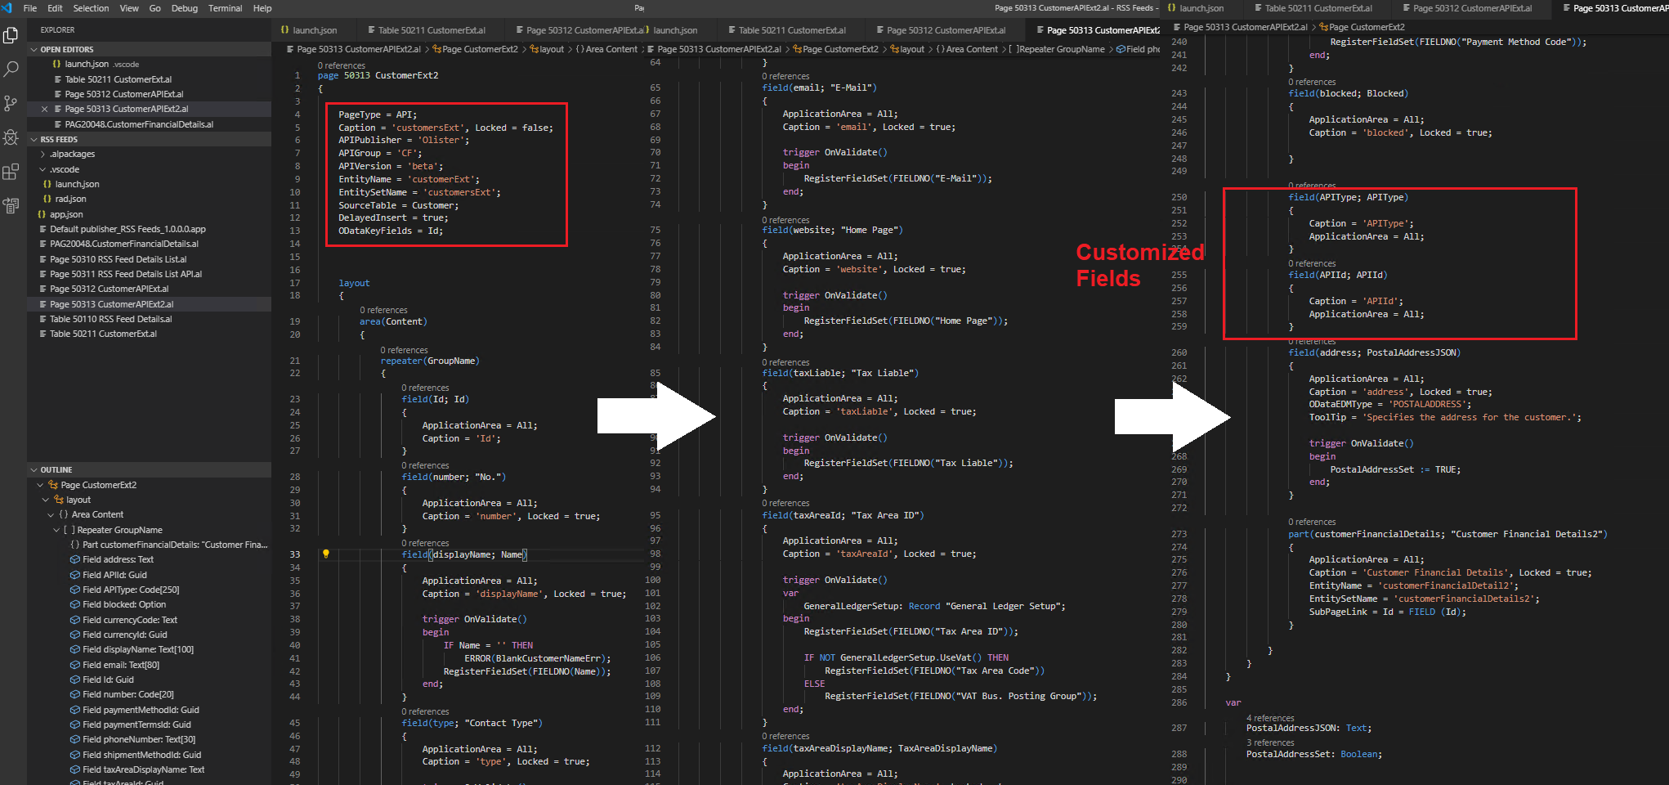
Creating API Page Extension

Slide 27
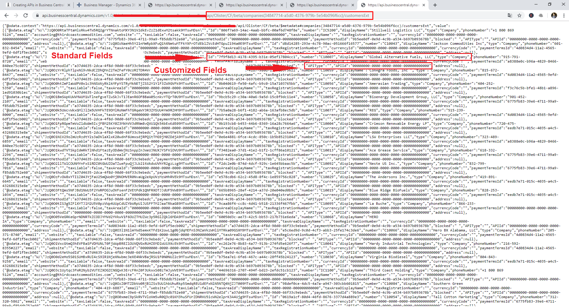
Creating API Page Extension

Slide 28
Using APIs to Integrate data with Business Central
Using MS-Flow to Integrate Data into Business Central

Slide 29
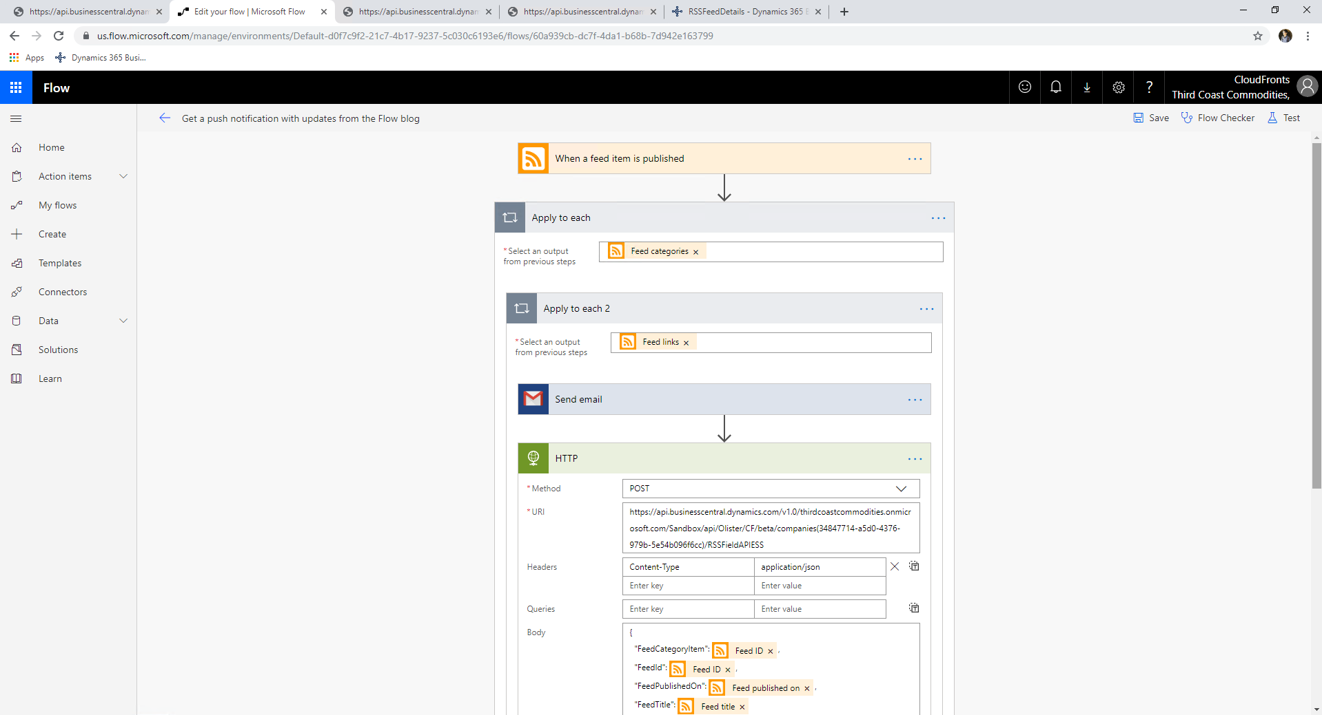
Creating a MS-Flow to Integrate Blog into Business Central
Calling APIs in POST to Insert Data into Business Central

Slide 30
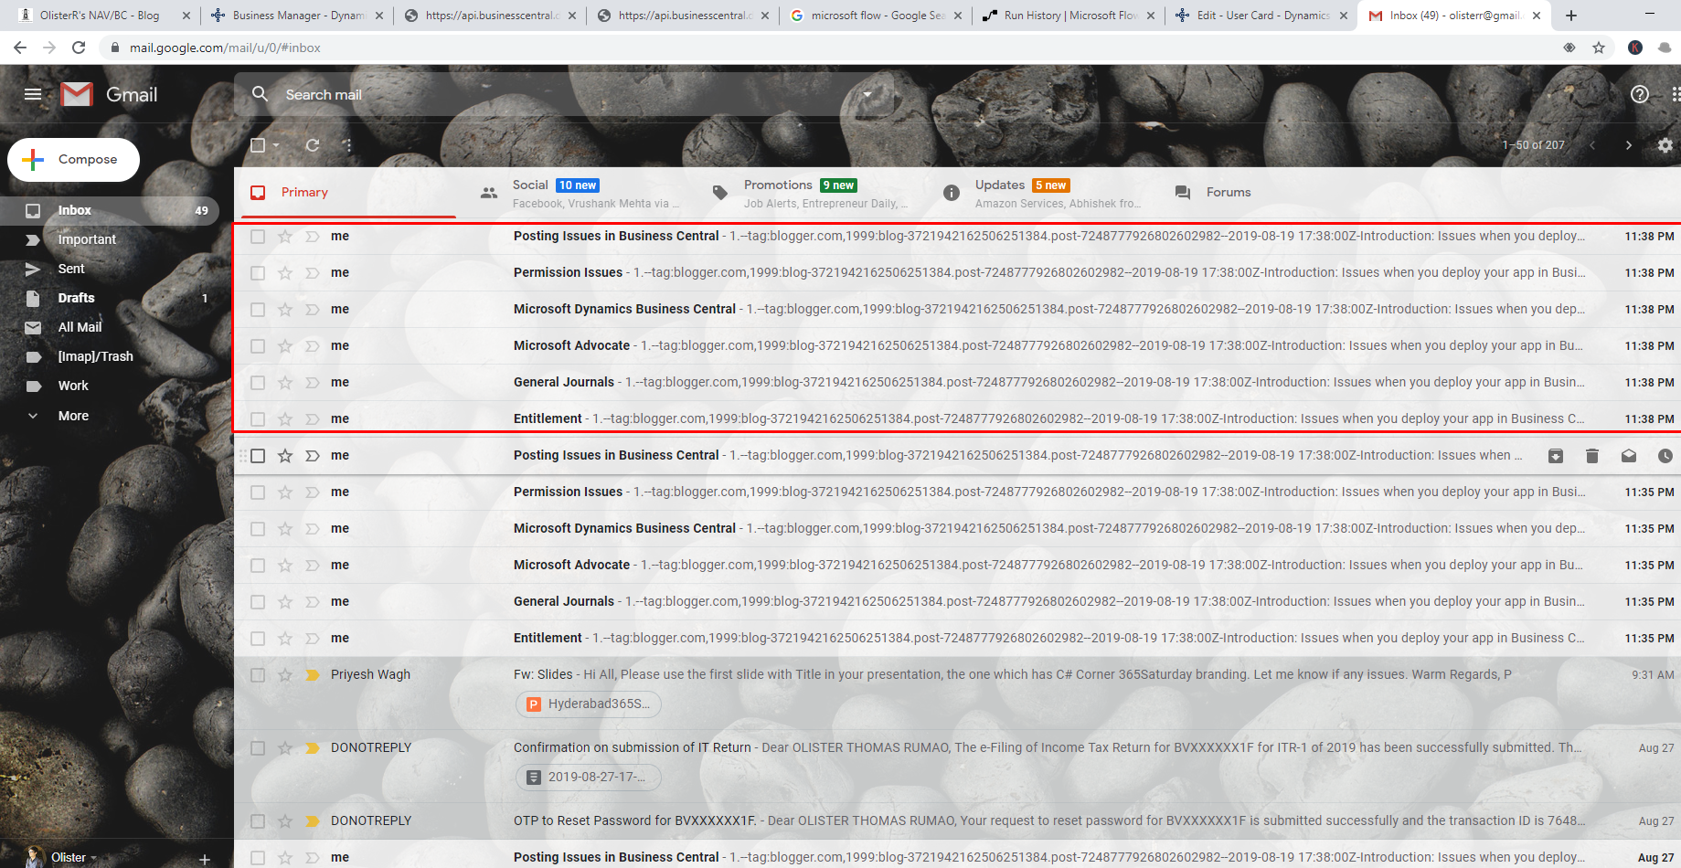
Checking if Email went out from MS-Flow

Slide 31
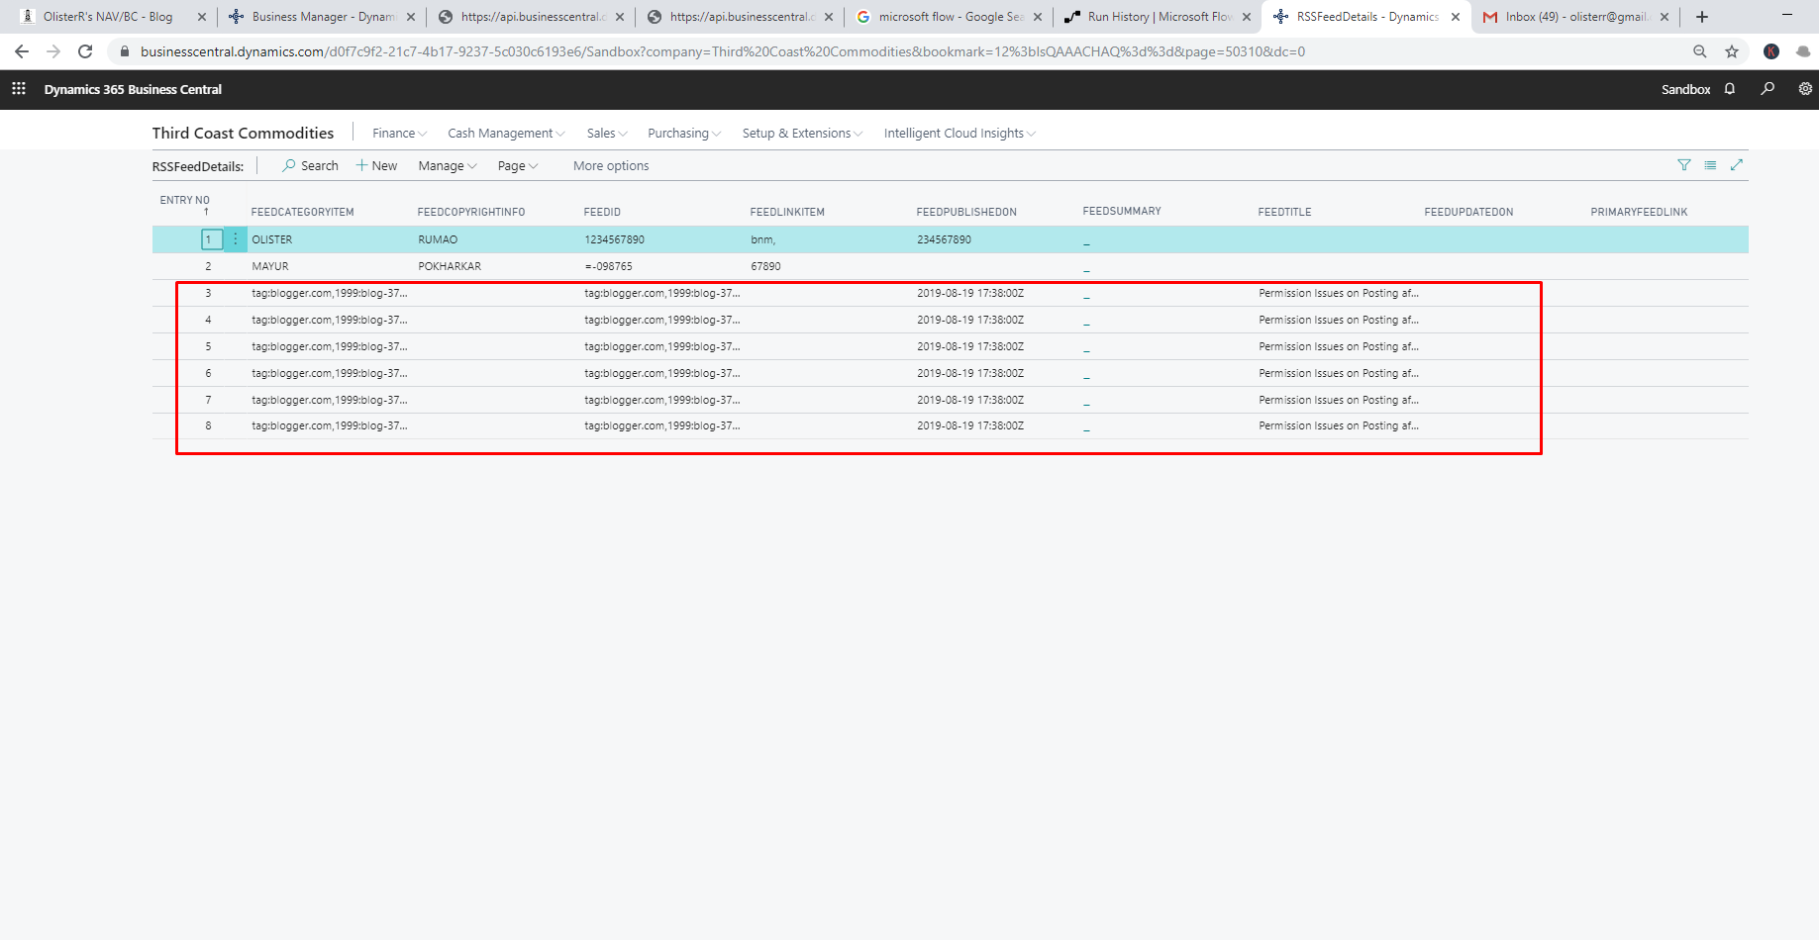
Checking if Data got integrated in Business Central

Slide 32
Thank You!

Slide 33
Olister Rumao
Dynamics NAV / Business Central Techno-Functional Consultant
CloudFronts, Mumbai
Blog: https://www.olisterr.tech/

